Slide 1
Building web front ends for desktop and mobile using the latest web standards
[Speaker]
[Company]
Email: [Email]
Twitter: [Twitter]

Slide 2
Today’s Agenda
Session | Start | End
Keynote | 8:30 | 9:00
Introduction to ASP.NET and Visual Studio 2015 Web Tools | 9:00 | 10:45
Break | 10:45 | 11:00
Building Web Applications using the latest ASP.NET technologies | 11:00 | 12:15
Lunch | 12:15 | 1:15
Building web front ends for both desktop and mobile using the latest web standards | 1:15 | 2:15
API Services for both web and devices | 2:15 | 3:15
Break | 3:15 | 3:30
Running, improving and maintaining a site in the real world | 3:30 | 4:30
Wrap Up | 4:30 | 5:00

Slide 3
Agenda
Modern web standards overview
JavaScript library overview
Building the GeekQuiz front-end

Slide 4
Modern Web Standards
HTML5 + CSS3 + JS = Magic!

Slide 5
HTML5

Slide 6
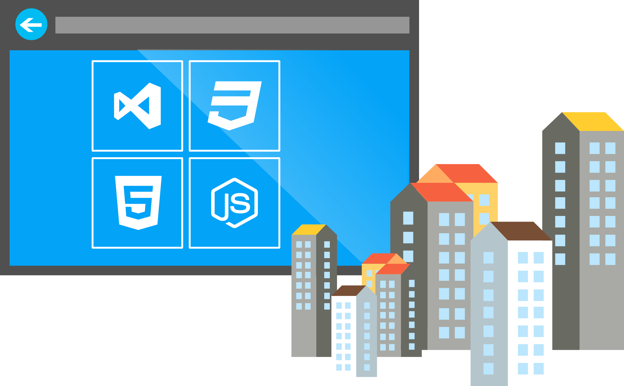

What is HTML5?
Umbrella term: vNext HTML, CSS, ECMAScript
Not a marketing message
A new set of standards for the Web Platform
Target many browsers, devices, and app platforms too

Slide 7

Why do you care?
Web ≈ Native
Standards mean you can target features, not browsers

Slide 8
HTML5 examples: Flight Sim Arcade 22Tracks Web Standards Test Drive
demo…
Notes:
Prioritize https://dev.modern.ie/testdrive/ - lots of great demos, growing list

Slide 9
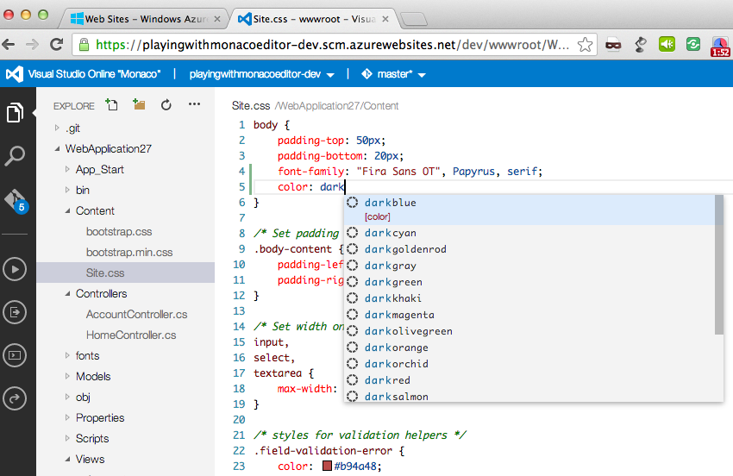
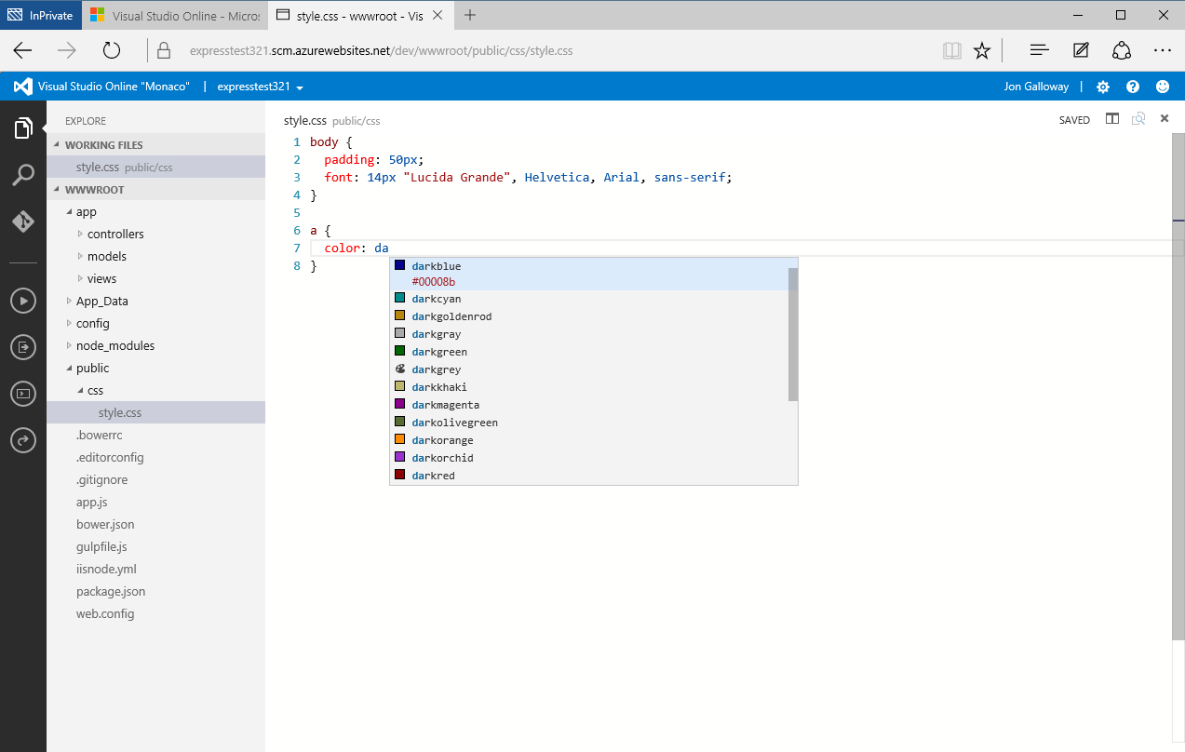
Visual Studio Online

Slide 10
Map of Web Browser Standards
HTML
CSS
Web Apps
SVG
Geolocation
ECMA Script 262
Standard
W3C
ECMA
Standards
Body

Slide 11
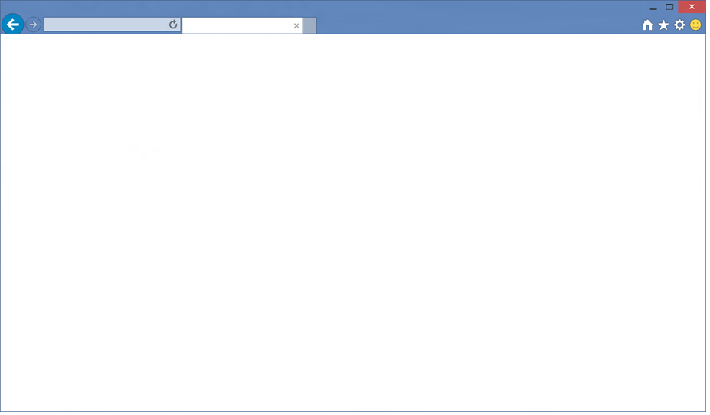
Internet Explorer
Internal engine switch enabled by CV lists, x-ua-compatible and meta tags
For sites requiring ActiveX, BHO, or legacy IE8 emulation through Enterprise Mode
Compatibility Engine mshtml.dll
IE5
Quirks
IE7
Compat View
IE8
Standards Mode
EMIE
Enterprise Mode
Silverlight
Java
Flash
BHOs
ActiveX
EMIE
IE9
Standards Mode
IE10
Standards Mode
QME
Quirks Mode Emulation
IE11
Standards Mode
BHO
ActiveX
Notes:
Balances compatibility with the latest web standards http://blogs.windows.com/msedgedev/2015/05/06/a-break-from-the-past-part-2-saying-goodbye-to-activex-vbscript-attachevent/

Slide 12
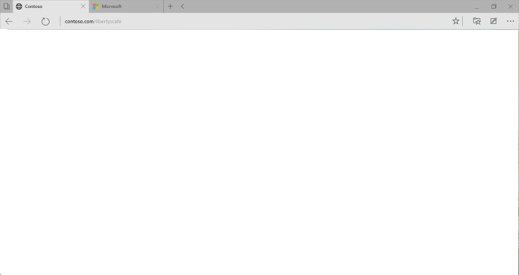

Microsoft Edge
EdgeHTML.dll
Evergreen
At browser interoperability intersection for desktop and mobile including Chrome, Firefox, Safari
New F12 DevTools
ActiveX, BHOs, and most legacy IE browser-specific coding practices deprecated
Notes:
Evergreen browser – continuously updated

Slide 13
Interoperability Features
5000+ Interoperability Fixes since IE11, Preserve-3d, Touch Events, CSS Filter Effects, DOM Clipboard Support, HTML Drag and Drop, Web Audio, CSS Position Sticky, CSS @supports, CSS Flexbox, HTML Beacon, WebDriver, IndexedDB, WebCrypto, Internationalization Mixed Languages Support, CSS Grid, CSS Variables, srcset, <picture> element, Web Workers Update, DOM4 Events, Font Loading, BDI, Cross-domain, HLS Manifest, Block Ellipsis, WAV, @rules, CSS Text(), CSS Border Logical, Logical Box Model, DOM Gamepad API, DOM FileSystem API, HTML <date> element, HTML <keygen> element, HTML <main> element, HTML <output> element, HTML <summary> element, HTML <detail> element, HTML <time> element, Native PDF, AppCache, SVG Hosting, Mutation Observers, HTML bidirectional, HTML Speech API, SVG animations, SVG transitions, SVG transforms, Canvas Path, Canvas Accessibility API, CSS Select Control, CSS Masking, CSS Clipping, Navigation Error Logging, CSS element(), CSS Shapes, ORTC, CSS Escape, Shared Workers, ES6 Modules, ES6 Promises, CSS Intrinsic & Extrinsic Sizing, Web Components, CSS Scoped Styles, HTTP 2.0, CSS Resize, WebGL, Canvas Blend Modes, CSS Interpolation, CSS Line Grid, CSS Line Box Contain, CSS Ruby, DOM Event Constructors, HTML <ol> Reverse, Server-Sent Events, Viewport APIs, Quota API, etc.
http://dev.modern.ie/platform/status
🔗 http://aka.ms/msedgecompat
Notes:
In addition to more than 4,000 interoperability fixes, we are focusing efforts on many interoperability features. For example, the Edge mode will now support webkit extensions that are popular on many websites. For more detail on the status of a particular web standard, you can visit http://dev.modern.ie/platform/status.

Slide 14
Building with web standards
Web Platform Status
Cross-browser testing
Feature Detection
Responsive and plug-in free
JS frameworks & libraries
CSS prefix best practices

Slide 15
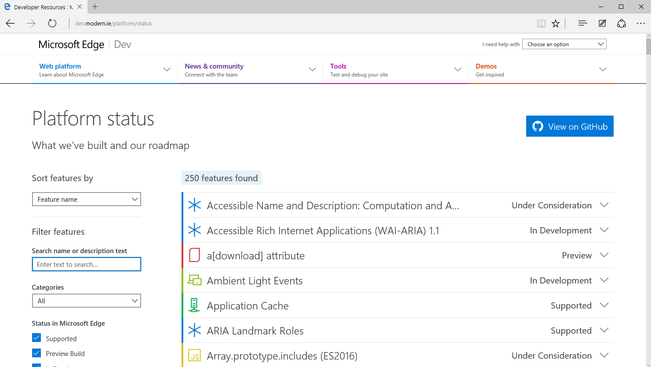
Web Platform Status
Notes:
Presenter:
Live demo – go to http://dev.modern.ie/platform/status – ask for features from audience

Slide 16
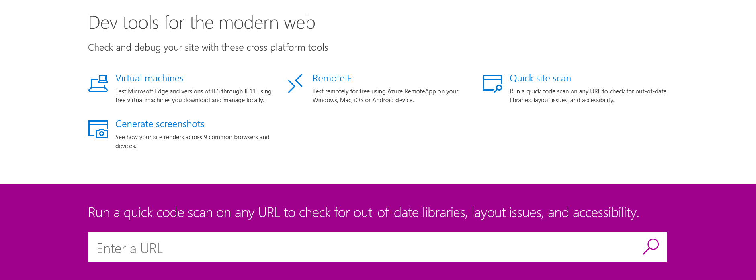
Cross-browser testing
//dev.modern.ie/tools
http://dev.modern.ie/tools

Slide 17

Feature detection
<script>
var comingSoonMessage = document.getElementById("hidden-message");
function isValidBrowser() {
var myNav = navigator.userAgent.toLowerCase();
var version;
if (myNav.indexOf('msie') != -1) {
version = parseInt(myNav.split('msie')[1])
return version > 8;
}
return true;
}
if (isValidBrowser()) {
comingSoonMessage.className = "fadeIn";
} else {
comingSoonMessage.className = "";
}
</script>
Code for features, not browsers
<script>
var comingSoonMessage = document.getElementById("hidden-message");
if (Modernizr.cssanimations) {
comingSoonMessage.className = "fadeIn";
} else {
comingSoonMessage.className = "";
}
</script>
Your parsing logic might have errors
Even if it’s perfect today… future user agent strings may break your code
Notes:
Full lab here: https://github.com/deltakosh/interoperable-web-development/tree/master/edge-mode-and-feature-detection

Slide 18
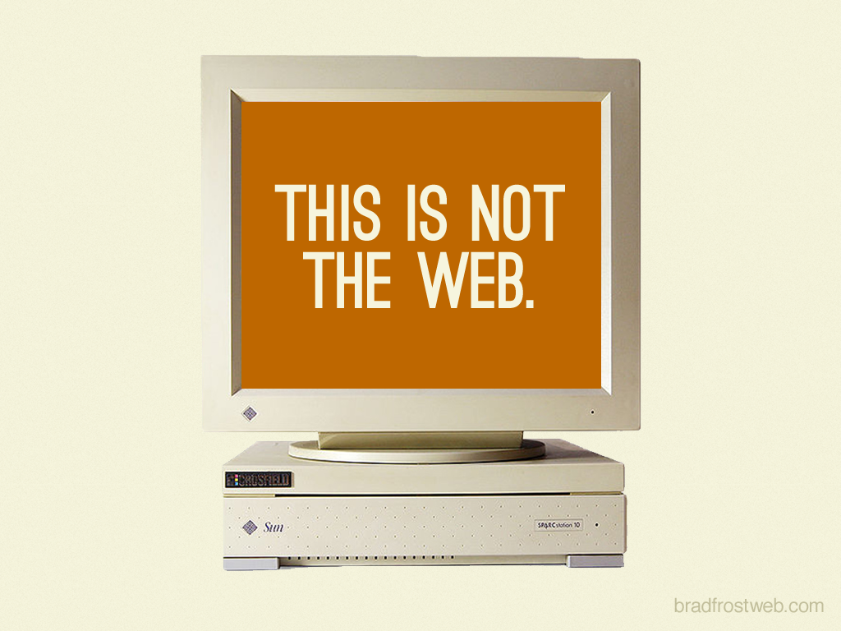
Responsive and plug-in free
http://bradfrost.com/blog/post/this-is-the-web/
Notes:
Source: http://bradfrost.com/blog/post/this-is-the-web/ Images are under Creative Commons Attribution License

Slide 19
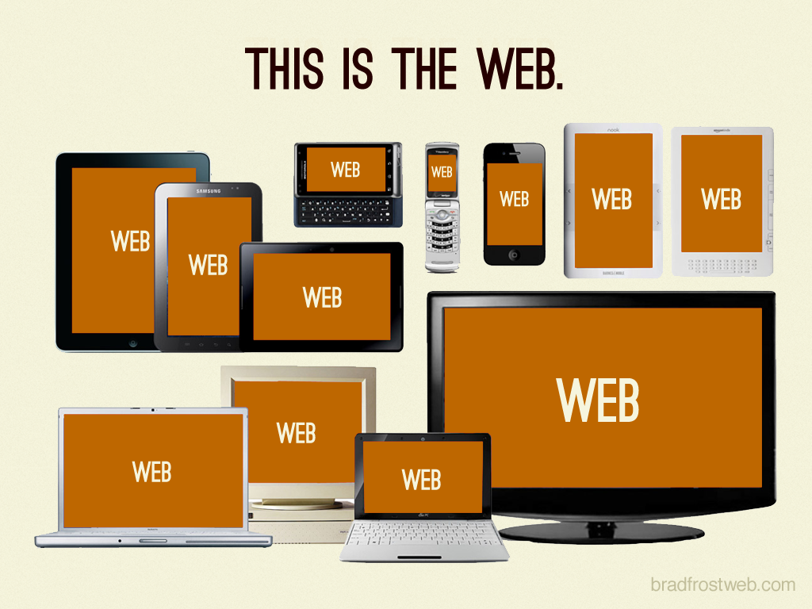
Responsive and plug-in free
http://bradfrost.com/blog/post/this-is-the-web/
Notes:
Source: http://bradfrost.com/blog/post/this-is-the-web/

Slide 20

Responsive and plug-in free
http://bradfrost.com/blog/post/this-is-the-web/
Notes:
Source: http://bradfrost.com/blog/post/this-is-the-web/

Slide 21
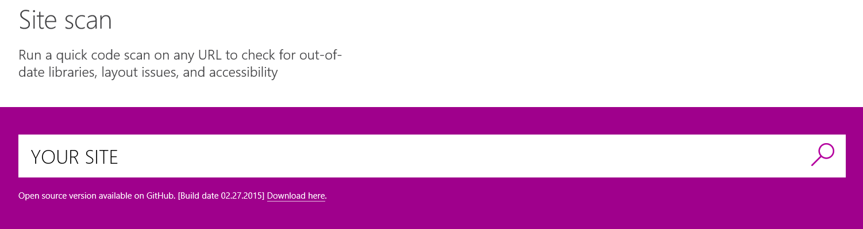
JavaScript frameworks & libraries
Keep them up to date!
Notes:
Updating jQuery, Modernizer
Pull in previous jQuery slides
Scan for outdated frameworks

Slide 22
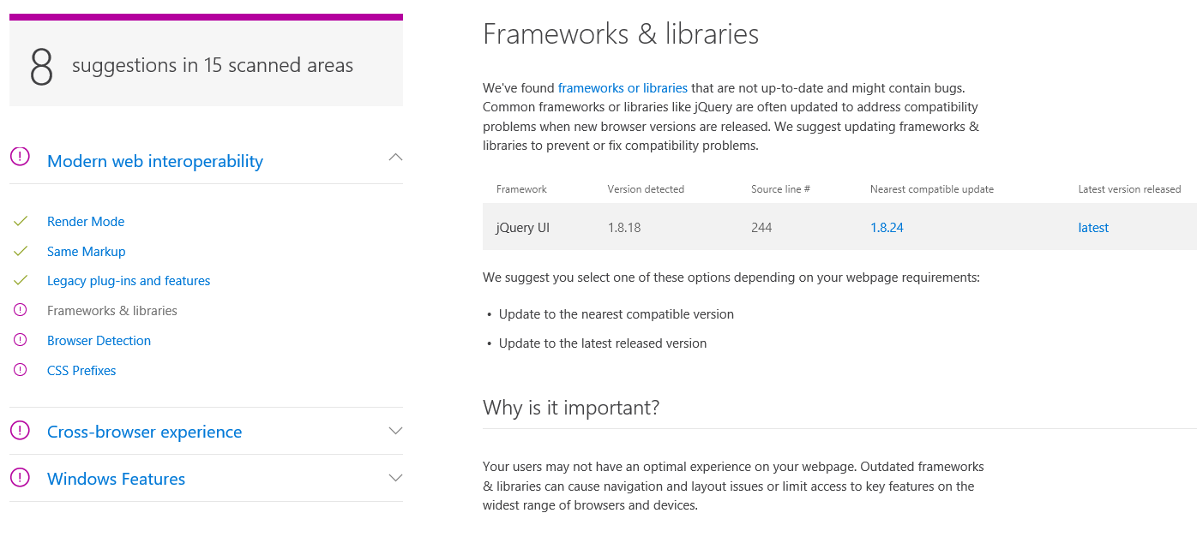
Keep them up to date!
Notes:
Frameworks and libraries like jQuery, jQueryUI, Modernizr, etc. can help you provide great user experiences, but you need to keep them up to date.

Slide 23
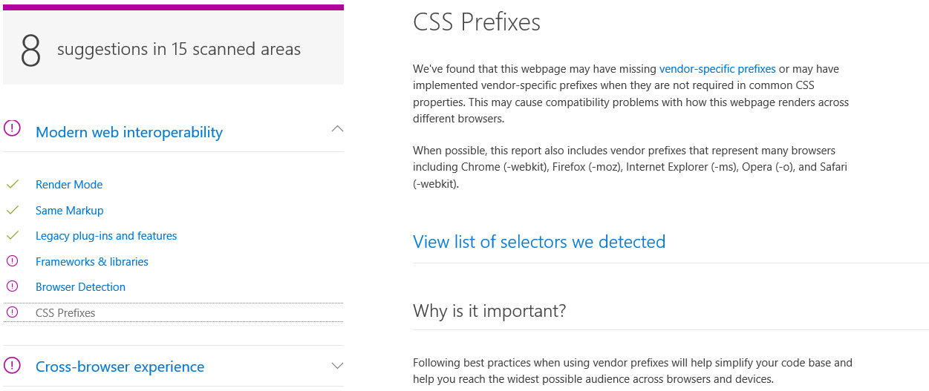
CSS prefix best practices
Notes:
Screenshot – compare Hawaiian airlines

Slide 24
New HTML5 Markup Elements
From this:
<div class=“header”></div>
<div class=“nav”></div>
To this:
<header></header>
<nav></nav>

Slide 25
New HTML5 Markup Elements
Eliminate the “generic” tagging
Native tags DOM parsing is quicker than class searching
Accessibility
Standardizing tags
Why?

Slide 26
Demo
HTML5 in ASP.NET Templates
Notes:
Distill the HTML5 Markup Concept
+Overview HTML5 Project Template
- New Semantic Tags
- Bootstrap Overview (CSS Reset, etc)

Slide 27
JavaScript Library Overview

Slide 28
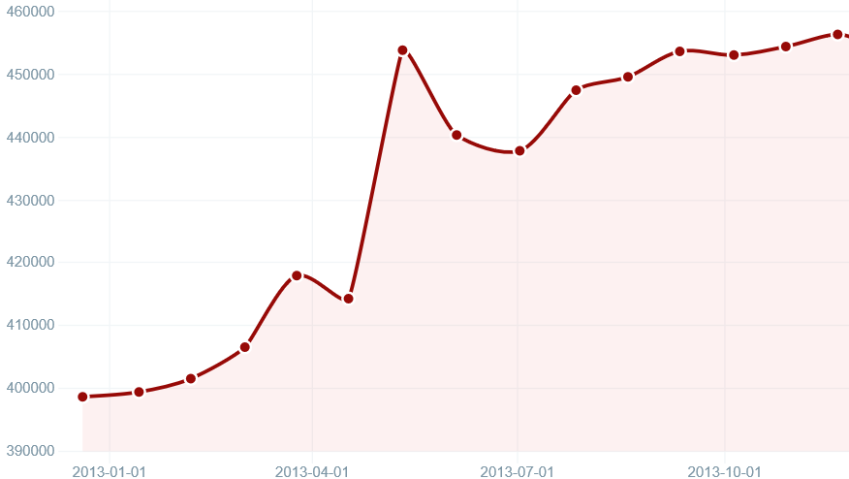
Who Uses jQuery?
Over 54 million sites
72% of the top 10k
Source: http://trends.builtwith.com/javascript/jQuery

Slide 29

jQuery – why so popular?
Easy to learn
Loads of Plugins
Powerful DOM Selection
Lightweight
Community Support

Slide 30
jQuery Community
jquery.com
api.jquery.com
forum.jquery.com
meetups.jquery.com
plugins.jquery.com
jqueryui.com
Downloading
Documentation
Community
Local Community
Extending
UI Widgets and Effects

Slide 31
jQuery Fundamentals
Find something, Do something
Functional Syntax
DOM Manipulation
Changing of events
<script>
$(function() {
$('.submit').click( function(){
$('.submit').css('color', '#ff0000');
$('#container')
.append($('<span>Clicked!</span>')
.click(function(){ alert('foo'); }));
});
});
</script>
<script>
$(‘div’).hide();
</script>
<div>This will be hidden</div>
<div>So will this</div>
<div>Even this</div>
<script>
$(function() {
$('.submit').click(function(){
alert('post form');
});
});
</script>
<input class=“submit” type=“button” value=“Submit”/>
<script>
$(function() {
$('.submit').click(function(){
alert('post form');
});
});
</script>
<input class=“submit” type=“button” value=“Submit”/>

Slide 32
Demo
jQuery
Notes:
http://jsbin.com/ijucaq/2/edit

Slide 33
Bootstrap

Slide 34
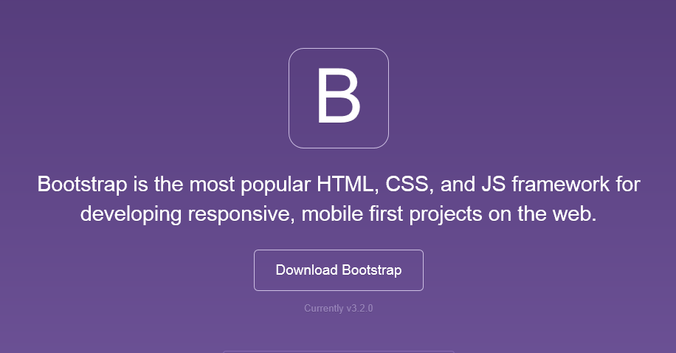
Bootstrap
The most popular front-end framework for developing responsive, mobile first projects on the web.

Slide 35
Why use it?
CSS is can be tricky
Cross browser support can be a challenge
Solves basic tasks (e.g. page layout without tables)
Bootstrap makes it easier

Slide 36
Bootstrap Features
Theme Support
Responsive
Grid
Components
Pagination
Buttons
Modal
Great Visual Studio support

Slide 37
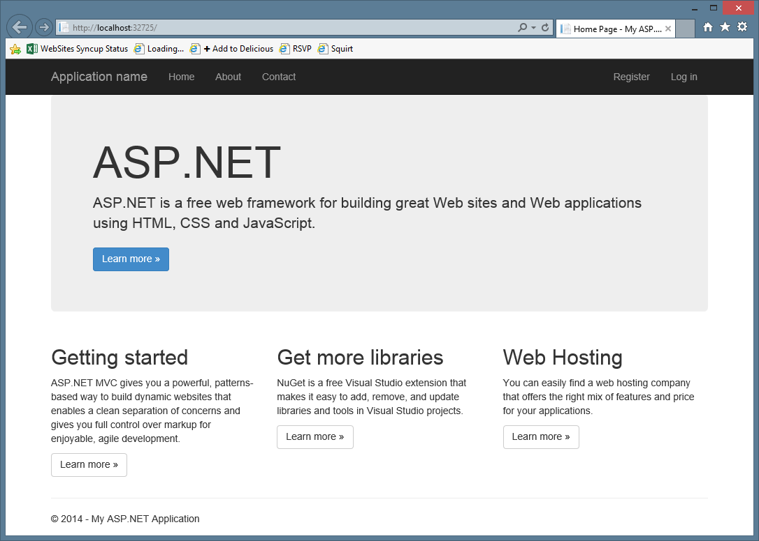
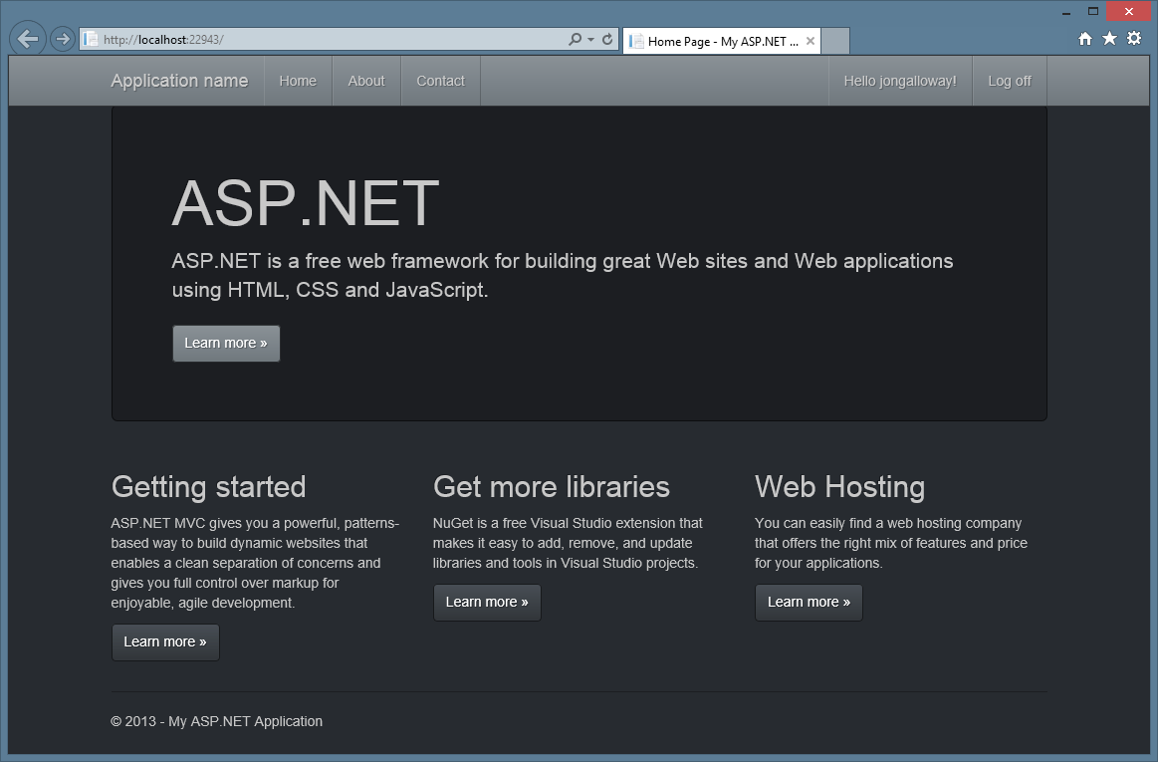
Themes

Slide 38
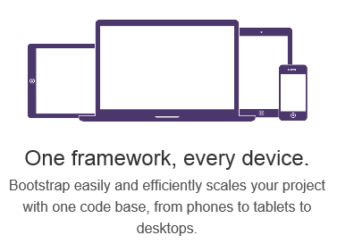
Responsive Layout

Slide 39
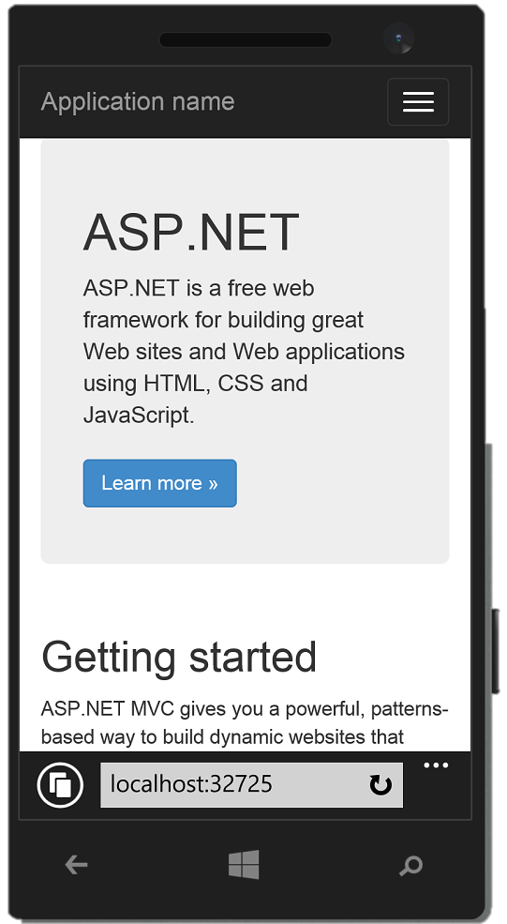
Responsive Layout

Slide 40
Grid system
 | Extra small devices Phones (<768px) | Small devices Tablets (≥768px) | Medium devices Desktops (≥992px) | Large devices Desktops (≥1200px)
Grid behavior | Horizontal at all times | Collapsed to start, horizontal above breakpoints
Container width | None (auto) | 750px | 970px | 1170px
Class prefix | .col-xs- | .col-sm- | .col-md- | .col-lg-
# of columns | 12
Column width | Auto | ~62px | ~81px | ~97px
Gutter width | 30px (15px on each side of a column)

Slide 41
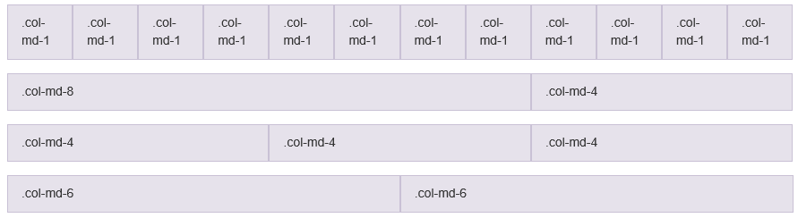
Grid system

Slide 42



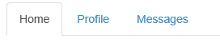

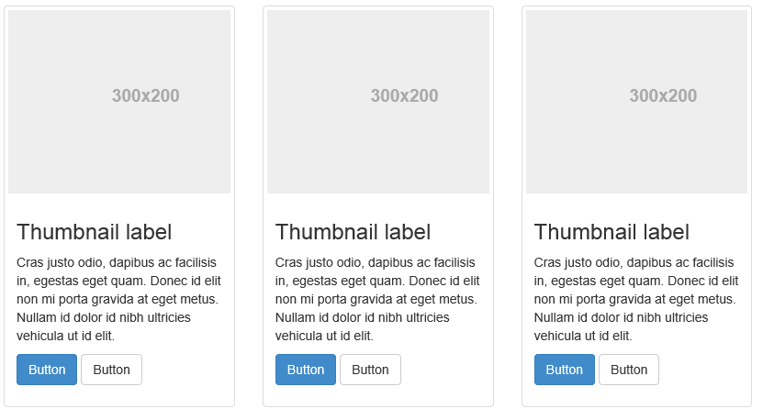
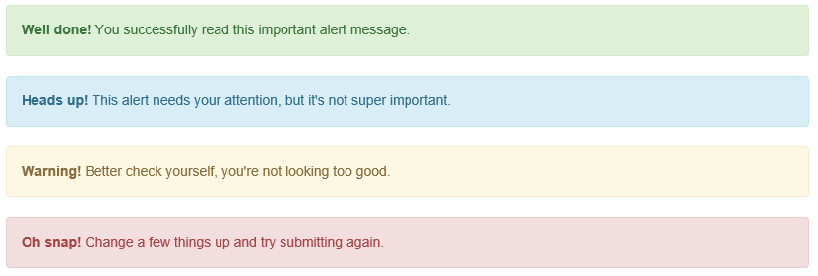
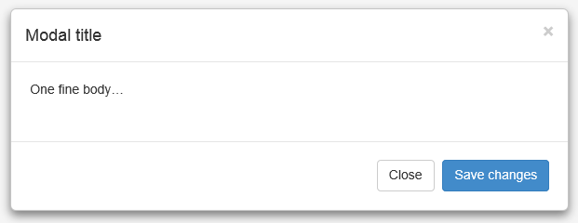
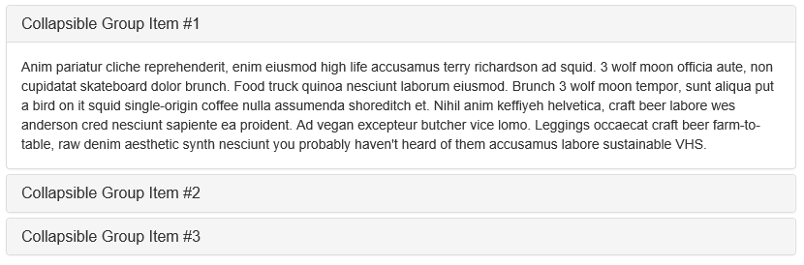
Components

Slide 43
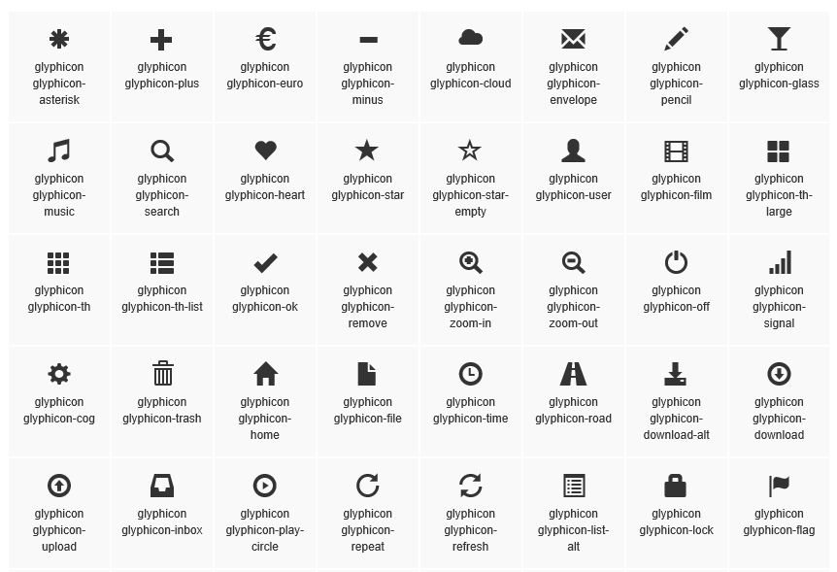
Glyphicons

Slide 44
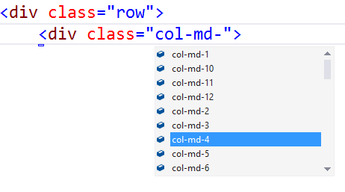
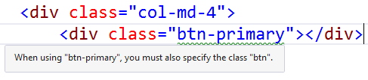
Bootstrap - Visual Studio support
CSS Class IntelliSense
Updated templates and MVC scaffolding to use Bootstrap classes
Web Essentials - Missing class detection

Slide 45
JavaScript Tools

Slide 46
Grunt / Gulp Overview
Front-end task runners
Bundle and minify CSS / JS
Run transpilers (JSX / LESS / Sass / Coffeescript / etc.)
Copy files (e.g. from bower_components to wwwroot)
Run tests (JS unit tests, browser automation tests)
Grunt and Gulp are both supported by Visual Studio

Slide 47
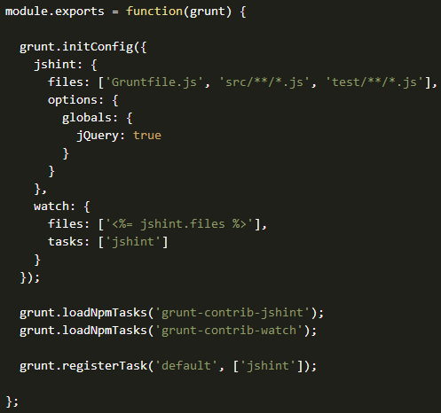

Grunt
JavaScript Task Runner
Automates minification, unit testing, compilation, etc.
Configuration over code
Common tasks already available as Grunt Plugins

Slide 48
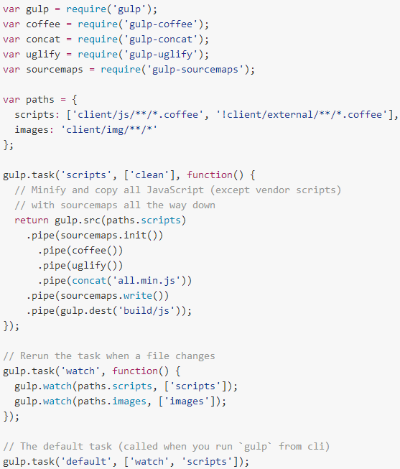

Gulp
Another JS Task Runner
Code over config
Streaming build system
Tasks are executed in maximum concurrency

Slide 49
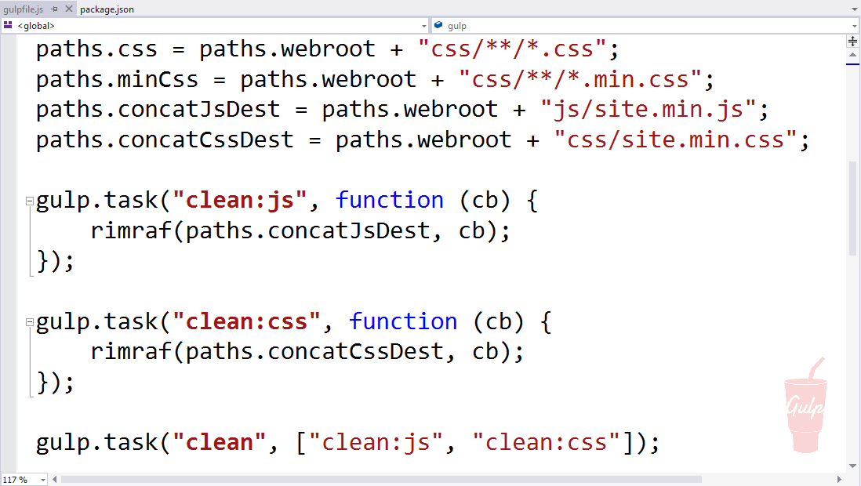
Visual Studio Support for Grunt / Gulp

Slide 50
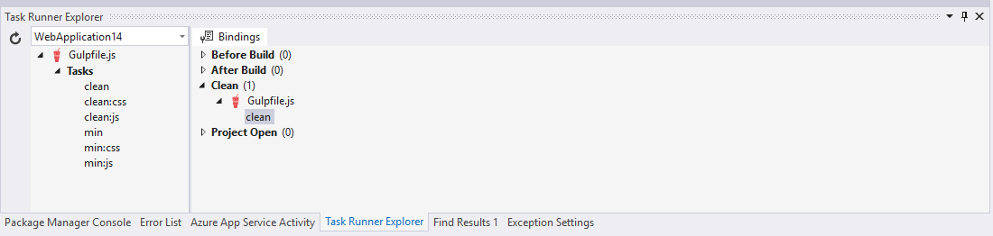
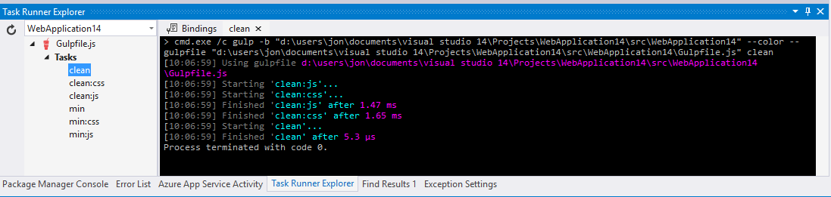
Visual Studio Support for Grunt / Gulp

Slide 51
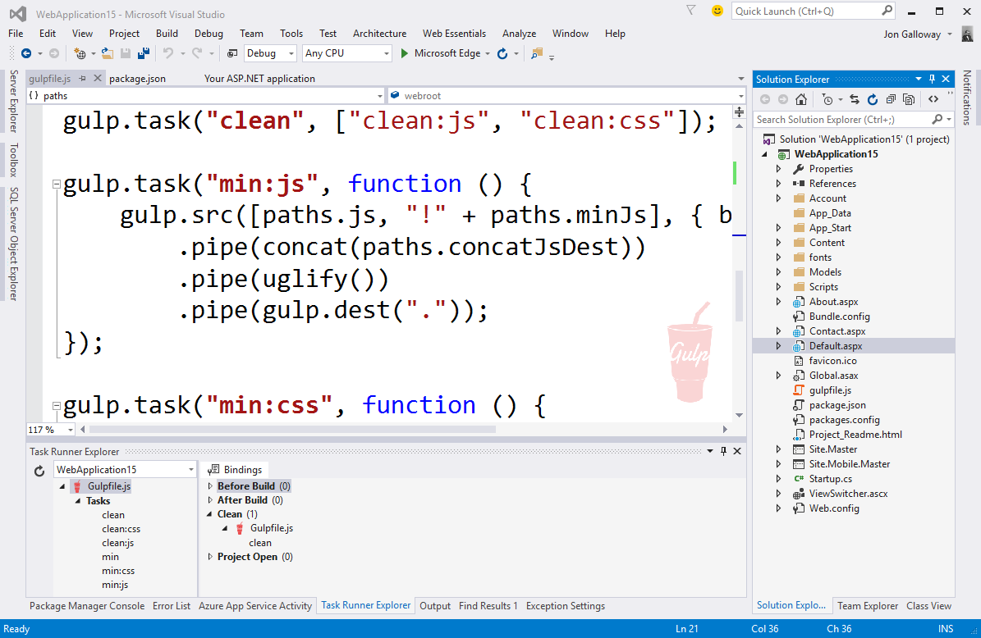
Works with all web project types
ASP.NET Core 1.0
ASP.NET 4.x Web Forms
ASP.NET MVC 5
HTML / Web Sites
Node.js
PHP
etc.
Notes:
This support is built in to Visual Studio, so it works with ASP.NET 4.x projects, Web Forms, etc.

Slide 52
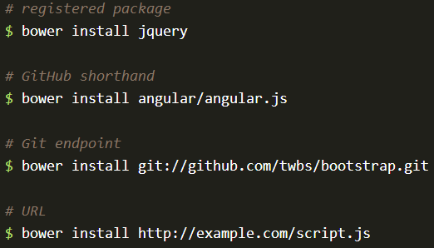

Bower
The package manager for the Web
50k existing users
>25k packages
Notes:
See http://bower.io/stats/

Slide 53
Single Page Applications
Overview and frameworks

Slide 54
Comparison: standard page requests
Client Browser
Request: http://site.com/products/
Web Server
HTML
CSS
Images
Javascript
Response: Full page
Request: http://site.com/products/6
Response: Full page
HTML
CSS
Images
Javascript

Slide 55
Comparison: Single Page Application
Client Browser
Request: http://site.com/products/
Web Server
HTML
CSS
Images
Javascript
Response: Full page
Request: http://site.com/products/6
Response: Tiny bit of data
{product}

Slide 56

AngularJS
<!doctype html>
<html ng-app="app">
<body>
<tabs>
<pane title="Localization">
Date: {{ '2013-04-01' | date:'fullDate' }} <br>
Currency: {{ 123456 | currency }} <br>
Number: {{ 98765.4321 | number }} <br>
</pane>
<pane title="Pluralization">
<div ng-controller="BeerCounter">
<div ng-repeat="beerCount in beers">
<ng-pluralize
count="beerCount“
when="beerForms">
</ng-pluralize>
</div>
</div>
</pane>
</tabs>
</body>
</html>
Custom Tag Attributes
Powerful Directives
Declarative Style
Strict Separation

Slide 57
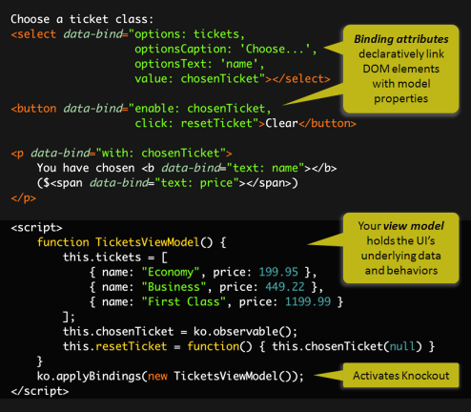
Knockout.js
Declarative Bindings
Automatic UI refresh
Dependency Tracking
Templating

Slide 58

React
Not MVC – Just V (UI)
Virtual DOM
One-way data flow
var HelloMessage = React.createClass({ render: function() { return <div>Hello {this.props.name}</div>; } }); ReactDOM.render(<HelloMessage name="John" />, mountNode);

Slide 59
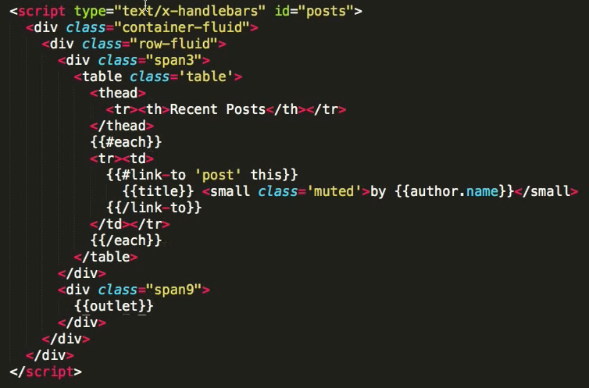

Ember.js
Ember is a framework
Convention over config
URLs are important

Slide 60
Demo
Building the GeekQuiz front end

Slide 61
Summary
Modern web standards overview
Single Page Applications
Building the GeekQuiz front end

